Slide 1
Deep Learning Basics Machine Learning Review Support Vector Machine (SVM)
Dr. Joongheon Kim School of Computer Science and Engineering, Chung-Ang University, Seoul, Korea URL: http://prof.cau.ac.kr/~joongheon E-mail: joongheon@cau.ac.kr ; joongheon@gmail.com

Slide 2

SVM (Outline)
Support Vector Machine (SVM)
Main Idea
Hyperplane in $n$-Dimensional Space
Brief Introduction to Optimization for SVM
SVM for Classification

Slide 3
Main Idea
How can we classify the give data?
Any of these would be fine. But which is the best?

Slide 4
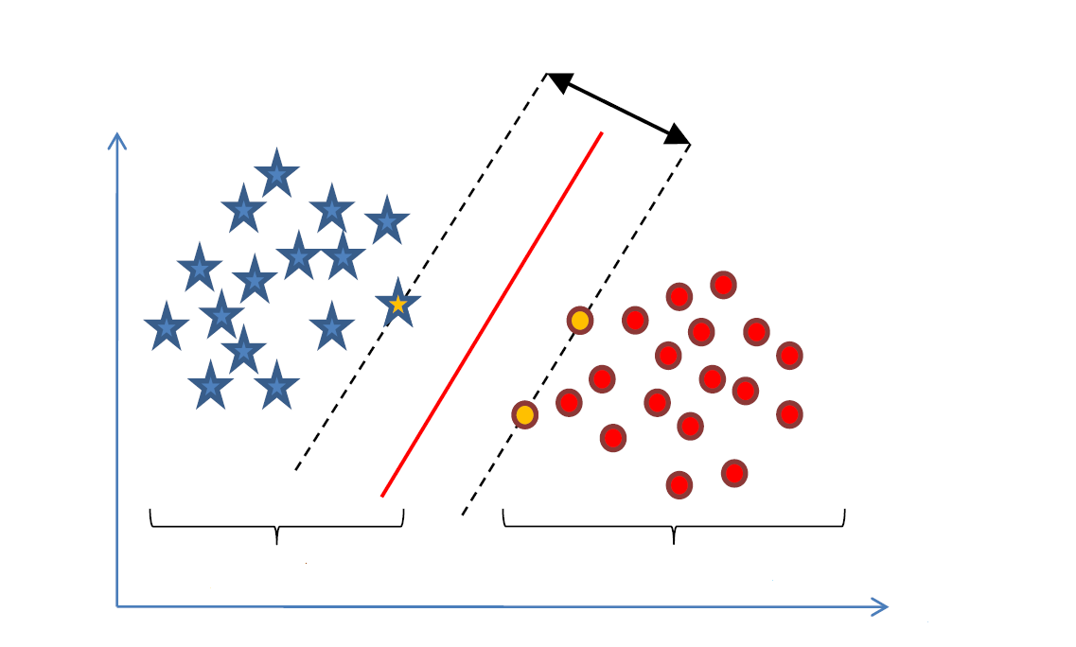
Main Idea
Find a linear decision surface (hyperplane) that can separate object classes and has the largest distance (i.e., largest gap (or margin)) between border-line objects (i.e., support vectors);
Gap
Shape
Banana
Apple
Color

Slide 5
Main Idea
Shape
Size
Apple
Apple
Kernel
Trick
Cherry
Cherry
Color
If linear decision surface does not exist, the data is mapped into a higher dimensional space (feature space) where the separating decision surface is found.
The feature space is constructed via mathematical projection (kernel trick).

Slide 6

Classification (Outline)
Support Vector Machine (SVM)
Main Idea
Hyperplane in $n$-Dimensional Space
Brief Introduction to Optimization for SVM
SVM for Classification

Slide 7
Hyperplane in $n$-Dimensional Space
[Definition (Hyperplane)] A subspace of one dimension less than its ambient space, i.e., the hyperplane in $n$-dimensional space means the $n−1$ subspace.

Slide 8
Hyperplane in $n$-Dimensional Space
Equations of a Hyperplane
An equation of a hyperplane is defined by a point ($P_{0}$) and a perpendicular vector to the plane ($\vec{w}$) at that point.
Define vectors: ${\vec{x}}_{0}$ and $\vec{x}$ where $P$ is an arbitrary point on a hyperplane.
A condition for $P$ to be one the plane is that the vector $\vec{x}−{\vec{x}}_{0}$ is perpendicular to $\vec{w}$:
The above equations hold for $R^{n}$ when $n>3$.
$$\vec{w}∙\left(\vec{x}−{\vec{x}}_{0}\right)=0$$
$$\vec{w}∙\vec{x}−\vec{w}∙{\vec{x}}_{0}=0$$
and define
$$b=−\vec{w}∙{\vec{x}}_{0}$$
$$\vec{w}∙\vec{x}+b=0$$

Slide 9
Hyperplane in $n$-Dimensional Space
Equations of a Hyperplane
$${\vec{x}}_{2}={\vec{x}}_{1}+t\vec{w}$$
$$D=\left\|t\vec{w}\right\|=\left|t\right|\left\|\vec{w}\right\|$$
$\vec{w}∙{\vec{x}}_{2}+b_{2}=0$
$\vec{w}∙\left({\vec{x}}_{1}+t\vec{w}\right)+b_{2}=0$
$\vec{w}∙{\vec{x}}_{1}+t{\left\|\vec{w}\right\|}^{2}+b_{2}=0$
$\left(\vec{w}∙{\vec{x}}_{1}+b_{1}\right)−b_{1}+t{\left\|\vec{w}\right\|}^{2}+b_{2}=0$
$−b_{1}+t{\left\|\vec{w}\right\|}^{2}+b_{2}=0$
$t=\left(b_{1}−b_{2}\right)/{\left\|\vec{w}\right\|}^{2}$
Therefore, $D=\left|t\right|\left\|\vec{w}\right\|=\left(b_{1}−b_{2}\right)/\left\|\vec{w}\right\|$
Distance between two parallel hyperplanes $\vec{w}∙\vec{x}+b_{1}=0$ and $\vec{w}∙\vec{x}+b_{2}=0$ is equivalent to $D=\frac{\left|b_{1}−b_{2}\right|}{\left\|\vec{w}\right\|}$.

Slide 10

Classification (Outline)
Support Vector Machine (SVM)
Main Idea
Hyperplane in $n$-Dimensional Space
Brief Introduction to Optimization for SVM
SVM for Classification

Slide 11
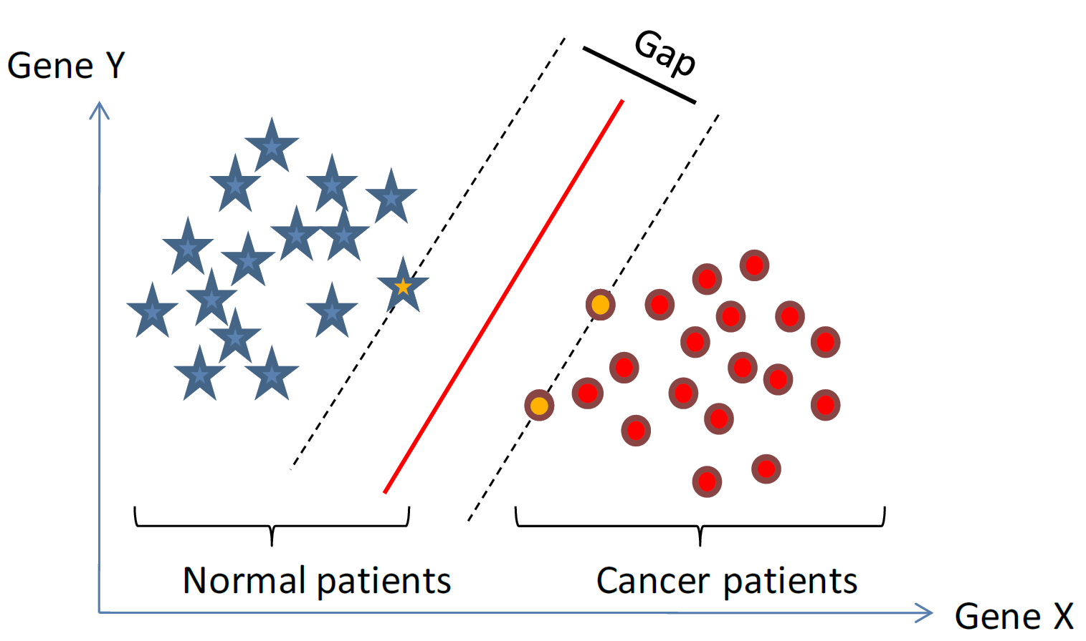
Brief Introduction to Optimization for Support Vector Machine
Now, we understand
How to represent data (vectors)
How to define a linear decision surface (hyperplane)
We need to understand
How to efficiently compute the hyperplane that separates two classes with the largest gap?
Shape
Need to understand the basics of relevant optimization theory
Banana
Apple
Color

Slide 12
Brief Introduction to Optimization for Support Vector Machine
Convex Functions
A function is called convex if the function lies below the straight line segment connecting two points, for any two points in the interval.
Property: Any local minimum is a global minimum.

Slide 13
Brief Introduction to Optimization for Support Vector Machine
Quadratic programming (QP)
Quadratic programming (QP) is a special optimization problem: the function to optimize (objective) is quadratic, subject to linear constraints.
Convex QP problems have convex objective functions.
These problems can be solved easily and efficiently by greedy algorithms (because every local minimum is a global minimum).

Slide 14
Brief Introduction to Optimization for Support Vector Machine
Quadratic programming (QP)
[Example], Constrained Optimization, i.e., Lagrange Multiplier is required.
Consider $\vec{x}=\left(x_{1},x_{2}\right)$
Minimize $\frac{1}{2}{\left\|\vec{x}\right\|}_{2}^{2}$ subject to $x_{1}+x_{2}−1≥0$
Quadratic Objective
Linear Constraints
Consider $\vec{x}=\left(x_{1},x_{2}\right)$
Minimize $\frac{1}{2}\left(x_{1}^{2}+x_{2}^{2}\right)$ subject to $x_{1}+x_{2}−1≥0$
Quadratic Objective
Linear Constraints

Slide 15

Classification (Outline)
Support Vector Machine (SVM)
Main Idea
Hyperplane in $n$-Dimensional Space
Brief Introduction to Optimization for SVM
SVM for Classification

Slide 16
SVM for Classification
SVM for Classification
(Case 1) Linearly Separable Data; Hard-Margin Linear SVM
(Case 2) Not Linearly Separable Data; Soft-Margin Linear SVM
(Case 3) Not Linearly Separable Data; Kernel Trick

Slide 17
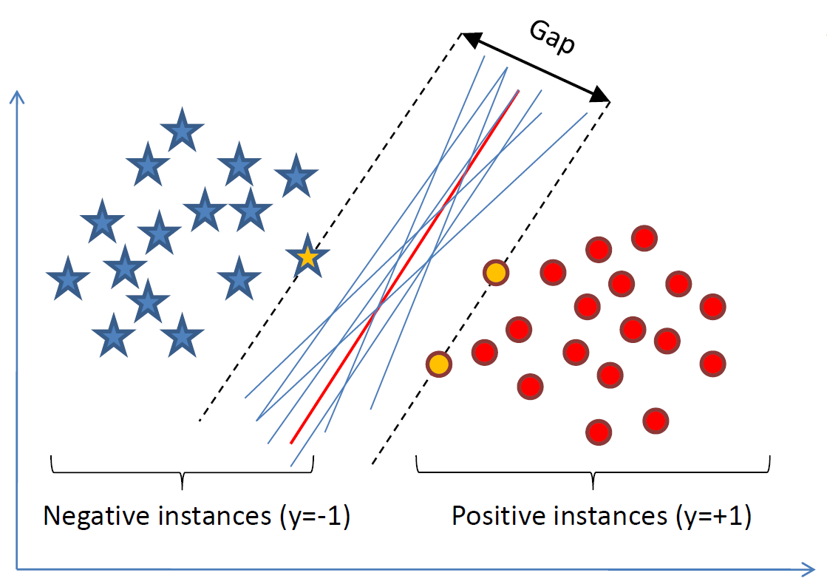
SVM for Classification
(Case 1) Linearly Separable Data; Hard-Margin Linear SVM
Want to find a classifier (hyperplane) to separate negative instances from the positive ones.
An infinite number of such hyperplanes exist.
SVMs finds the hyperplane that maximizes the gap between data points on the boundaries (so-called support vectors).
If the points on the boundaries are not informative (e.g., due to noise), SVMs will not do well.

Slide 18
SVM for Classification
(Case 1) Linearly Separable Data; Hard-Margin Linear SVM
The gap is distance between two parallel hyperplanes: $\vec{w}∙\vec{x}+b=−1$ and $\vec{w}∙\vec{x}+b=+1$
Now, we know that $D=\frac{\left|b_{1}−b_{2}\right|}{\left\|\vec{w}\right\|}$, i.e., $D=\frac{2}{\left\|\vec{w}\right\|}$.
Since we have to maximize the gap, we have to minimize $\left\|\vec{w}\right\|$.
Or equivalently, we have to minimize $\frac{1}{2}{\left\|\vec{w}\right\|}^{2}$.

Slide 19
SVM for Classification
(Case 1) Linearly Separable Data; Hard-Margin Linear SVM
In addition, we need to impose constrains that all instances are correctly classified. In our case, $\vec{w}∙{\vec{x}}_{i}+b≤−1$ if $y_{i}=−1$ $\vec{w}∙{\vec{x}}_{i}+b≥+1$ if $y_{i}=+1$., i.e., equivalently, $y_{i}\left(\vec{w}∙{\vec{x}}_{i}+b\right)≥1$.
In summary,
Minimize $\frac{1}{2}{\left\|\vec{w}\right\|}^{2}$ subject to $y_{i}\left(\vec{w}∙{\vec{x}}_{i}+b\right)≥1$, for $i=1,⋯,N$

Slide 20
SVM for Classification
(Case 2) Not Linearly Separable Data; Soft-Margin Linear SVM
What if the data is not linearly separable? E.g., there are outliers or noisy measurements, or the data is slightly non-linear.
Approach
Assign a slack variable to each instance $ξ_{i}≥0$, which can be thought of distance from the separating hyperplane if an instance is misclassified and $0$ otherwise.
Minimize $\frac{1}{2}{\left\|\vec{w}\right\|}^{2}+C\sum_{i=1}^{N}{ξ_{i}}$ subject to $y_{i}\left(\vec{w}∙{\vec{x}}_{i}+b\right)≥1−ξ_{i}$, for $i=1,⋯,N$

Slide 21
SVM for Classification
(Case 3) Not Linearly Separable Data; Kernel Trick
Data is not linearly separable in the input space
Data is linearly separable in the feature space obtained by a kernel
Shape
Size
Apple
Apple
Kernel
Trick
Cherry
Cherry
Color

